Slide 1
Week 2 Updates: SolidWorks DFM Plug-In
Ruoyu Song
Dr. Cassandra Telenko
Aniruddh Marellapudi

Slide 2
Updates from Week 2
File exporting functionality has been implemented
Can output as STL, DWG, STEP, and PDF (for drawings)
Picture import functionality has been added
See Demo
Created simple UI so user can select and analyze features, then export part for manufacturing
Started accessing feature-specific information through SolidDna (custom API) and the official SolidWorks API. More to be done here!
This will allow for feature-specific DFM checking (extrusion depth, hole depth/radii, etc)

Slide 3
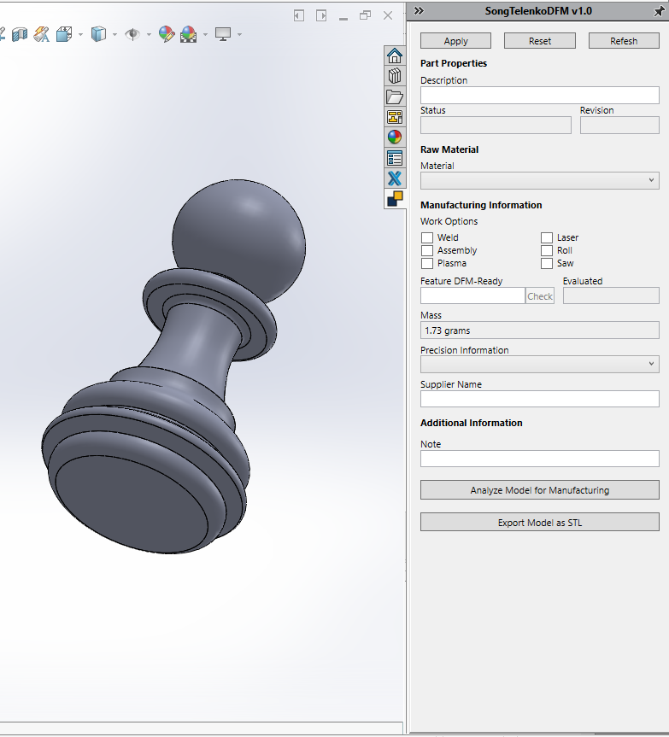
Demo

Slide 4
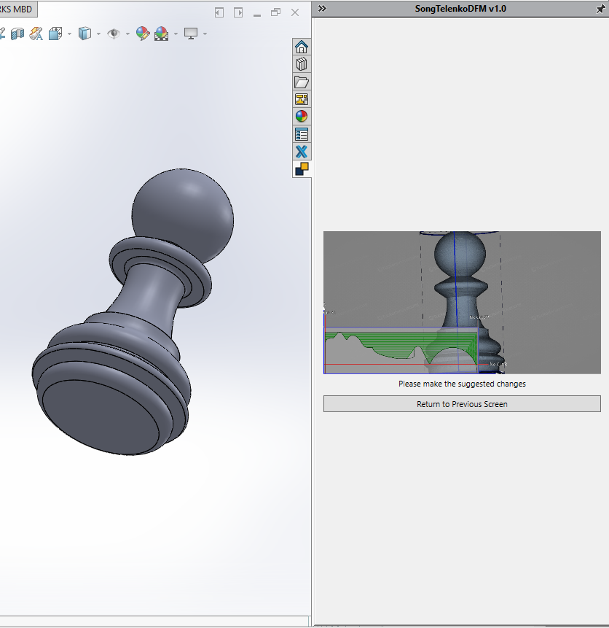

Slide 5
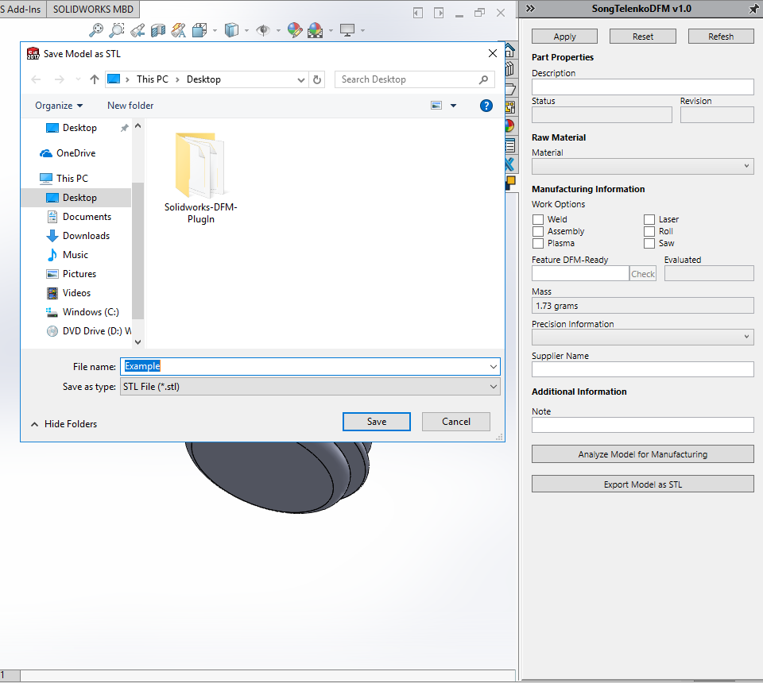

Slide 6
Next Steps
Goal: make a set of all features and dimensions, then run through a DFM check function
Interface with SculptPrint
Can we run a python script from within SolidWorks, or will this be external?
Dynamically show the SculptPrint results in the plug-in
Document everything thoroughly. This project is confusing to set-up, so I will make a guide

Slide 7
Quick Project Decisions
Need a proper name and description to display in SolidWorks
Design desired interface (sketch/draw)

Slide 8
Problems List and Solution
AngelSix Add-In Installer returns with an error
The add-in installer runs RegAsm.exe to register your plug-in’s .dll
Can debug manually
cd C:\Windows\Microsoft.NET\Framework64\v4.0.30319
RegAsm.exe /codebase "C:\Users\Aniruddh\Desktop\solidworks-api-develop\Tutorials\DynamicReload\DynamicReload\bin\Debug\DynamicReload.dll"

Slide 9
Problems List and Solution (Cont’d)
Packages downloaded from GitHub do not compile because Dna.Framework is not a valid namespace
Dna.Framework, also written by AngelSix, is a NuGet package
NuGet is a free, open-source package manager in Visual Studio
Make sure this package is properly installed (with dependencies) for each solution

Slide 10
Problems List and Solution (Cont’d)
Make sure SolidWorks Interop files (SolidWorks Native API) have the same version as those referenced by AngelSix API
AngelSix API uses .NET Framework 4.7.1, so make sure this is consistent with your solution

Slide 11
Problems List and Solution (Cont’d)
Installing add-in shows too many Command Manager Items
Renaming the project when you have a Command Manager Item plug-in causes this
Have not found the fix so far
Possible walk-around: clone the project, and export a new .dll

